Slide 1

Lisbon Housing Market Study
Price Analysis and Forecast
Group 3 – TP2
Programming for Data Science
2024

Slide 2
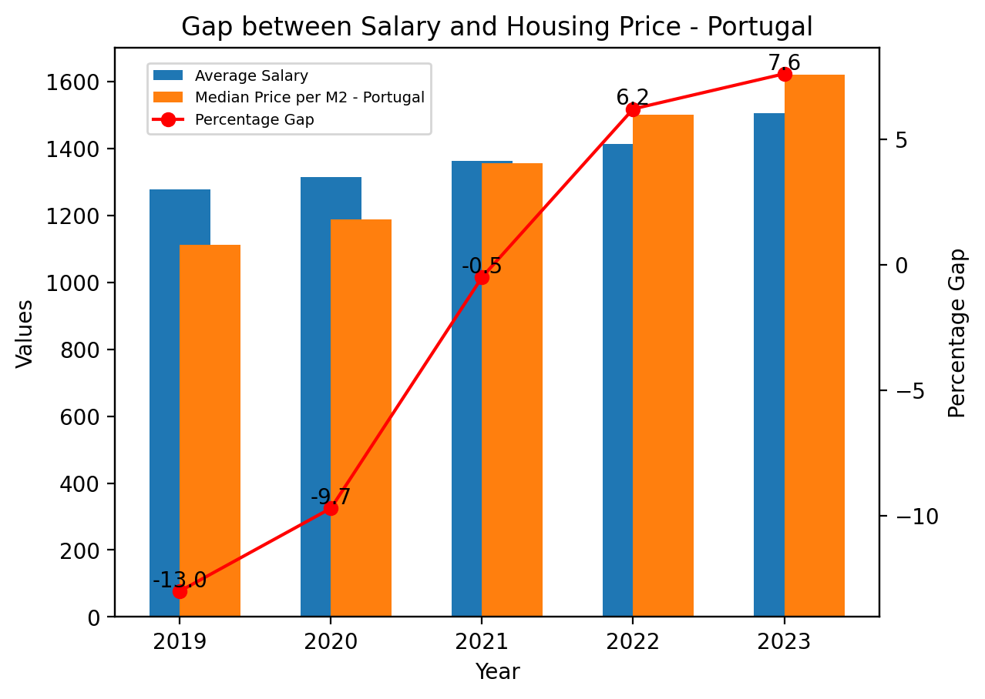
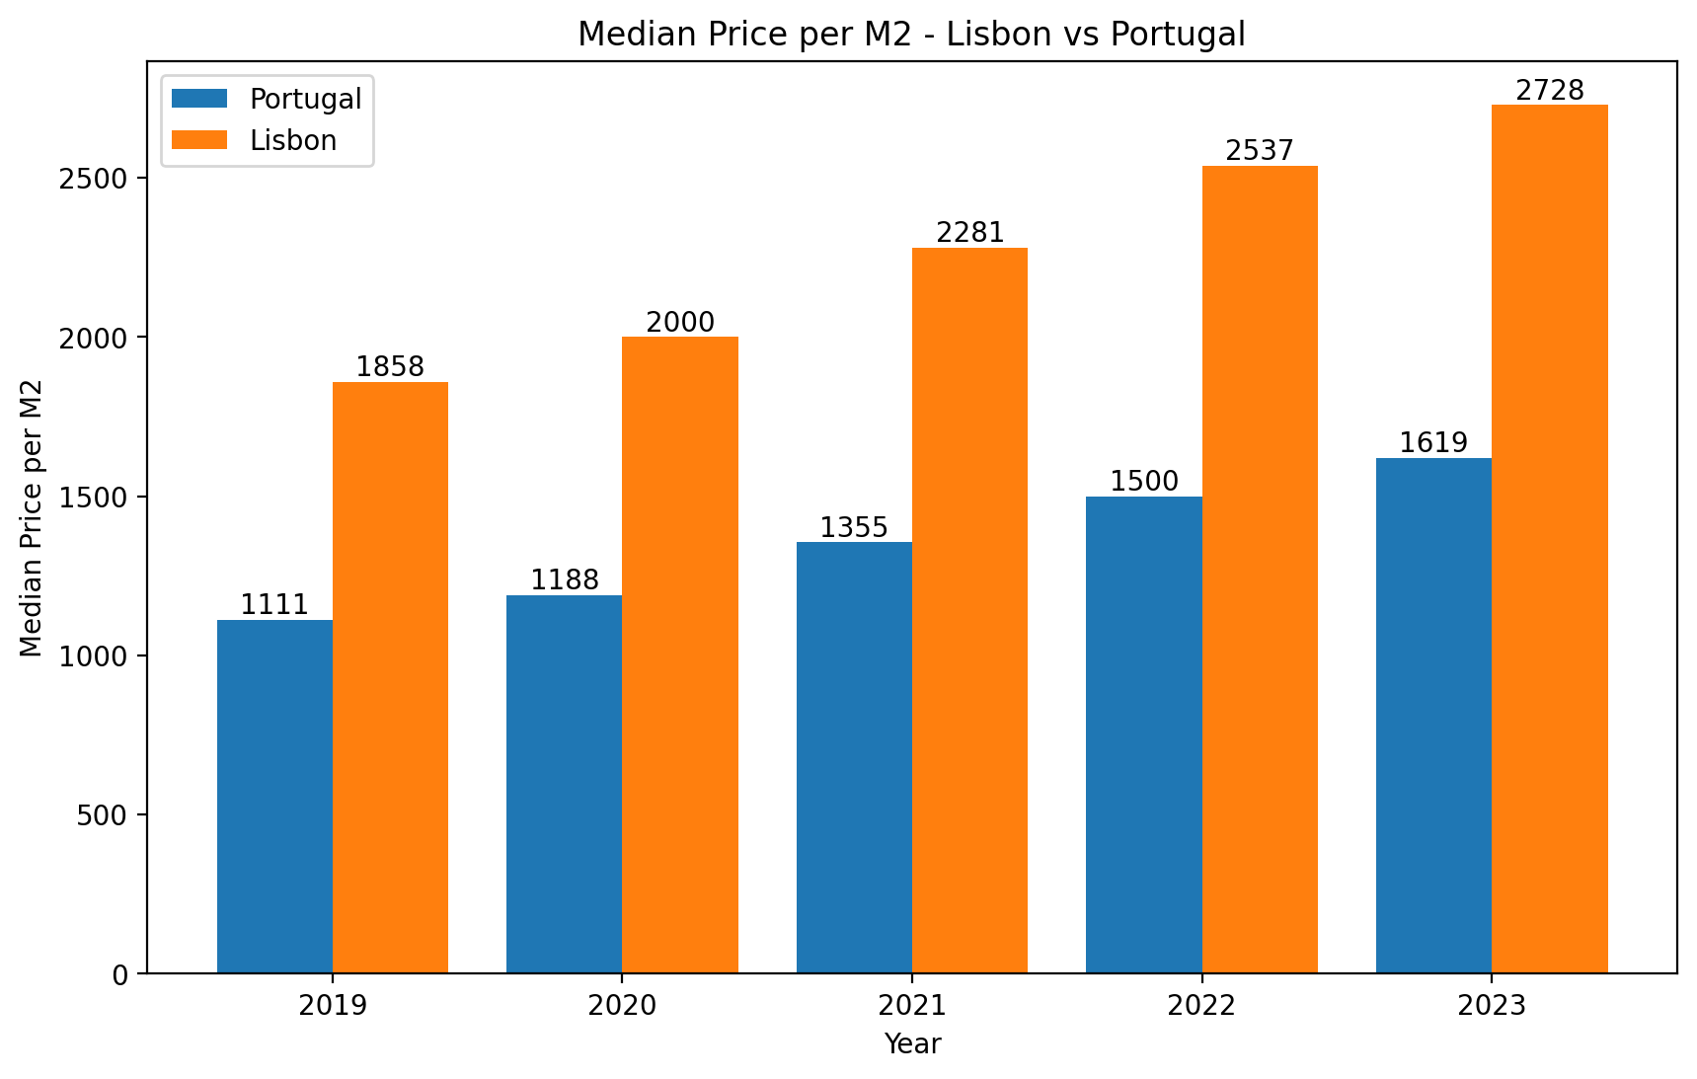
Why this topic and its importance - Portugal
Data from the Portuguese Statistics Institute
Data from the Portuguese Statistics Institute
Gap between Average Salary in Portugal and the Square Meter Price has been increasing sharply
The cost per square meter in Lisbon is even higher by almost 70% in 2023, when comparing with Portugal
Programming for Data Science
2024

Slide 3
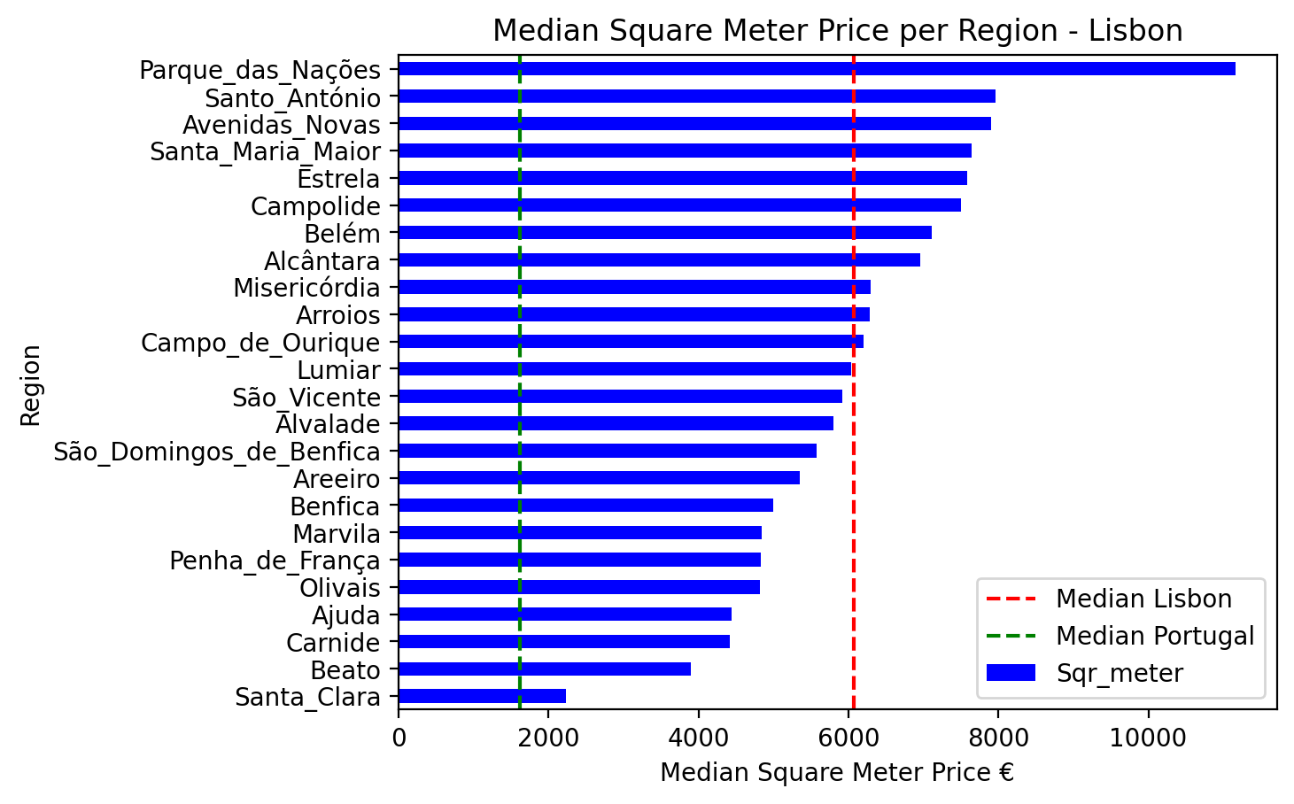
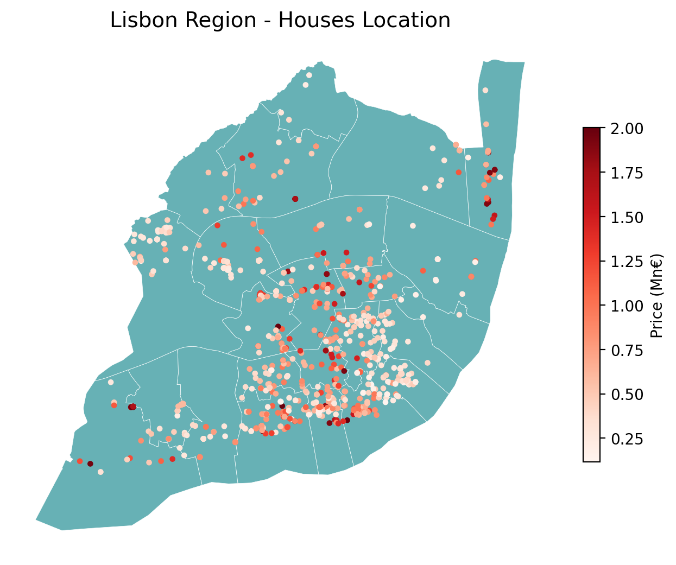
Why this topic and its importance – Lisbon (Supercasa)
Using the data obtained via Webscrapping on the Supercasa website, the median values per square meter in Lisbon surpasses 6000€
Value in line with other house search engines, such as Idealista, where the value is above 5000€
No region in Lisbon has a lower median value than the national median
Predictive Modelling could be a useful tool to understand which variables contribute more to this difference in the Lisbon area
Programming for Data Science
2024

Slide 4
Thank you
Questions?

